Slide 1
Software Construction
- Vijay Anand

Slide 2
Learning Target
You
can explain the importance of continuous integration (CI)
know what Continuous Integration is
can explain the benefits of CI
can describe a typical CI environment
can setup and use a CI tool
Difference between CI - CD

Slide 3
Agenda
Why Integration?
What is Continuous Integration?
Continuous Integration Process
CI Infrastructure
CI Tools

Slide 4
Integration
Integration is … Making different modules work together
Modularization
enables team development
makes complex systems manageable
Modules have to work together
i.e. they must be integrated
Integrated Modules do successfully
compile
run
pass
test
deploy

Slide 5
Broken Integration
You have a broken integration when:
Source code server does not build successfully
Shared component works in one system, but breaks others
Unit tests fail
Code quality fails (coding conventions, quality metrics)
Deployment fails
The earlier you can detect problems, the easier it is to resolve them

Slide 6
Manual Integration
Integration becomes expensive
if made manual (build, test, deployment, …)
with too less checkin’s (hours or days…)
If integration problems and bugs are detected too late

Slide 7
What is Continuous Integration?
Continuous Integration is the practice of testing each change done to your codebase automatically and as early as possible.
“An important part of any software development process is getting reliable builds of the software. Despite it's importance, we are often surprised when this isn't done. We stress a fully automated and reproducible build, including testing, that runs many times a day. This allows each developer to integrate daily thus reducing integration problems.”

Slide 8
Practices of Continuous Integration
Maintain a Single Source Repository.
Make Your Build Self-Testing
Everyone Commits Every Day
Your team will need to write automated tests for each new feature, improvement or bug fix.
You need a continuous integration server that can monitor the main repository and run the tests automatically for every new commits pushed.
Make it Easy for Anyone to Get the Latest Executable
Everyone can see what's happening
Automate Deployment From
http://martinfowler.com/articles/continuousIntegration.html

Slide 9
Benefits of Continuous Integration and Continuous Delivery
Smaller Code Changes
Fault Isolations
Faster Mean Time To Resolution (MTTR)
More Test Reliability
Faster Release Rate
Smaller Backlog
Customer Satisfaction
Increase Team Transparency and Accountability
Reduce Costs
Easy Maintenance and Updates

Slide 10
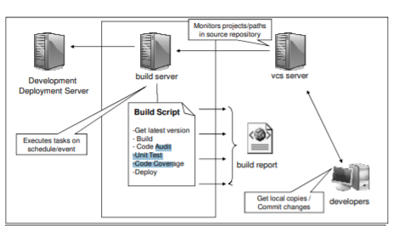
Continuous Integration Infrastructure (old)

Slide 11
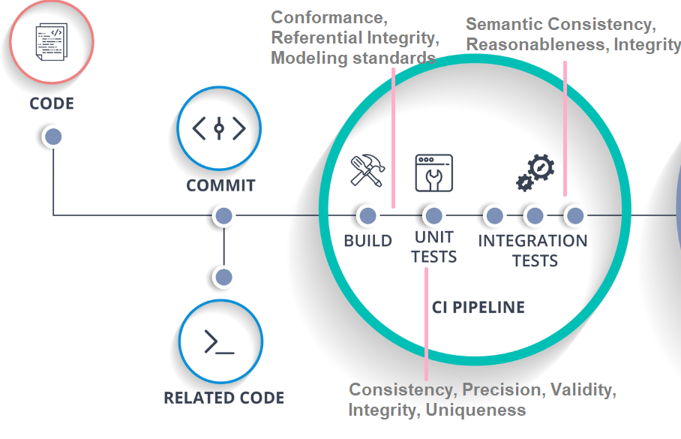

Slide 12
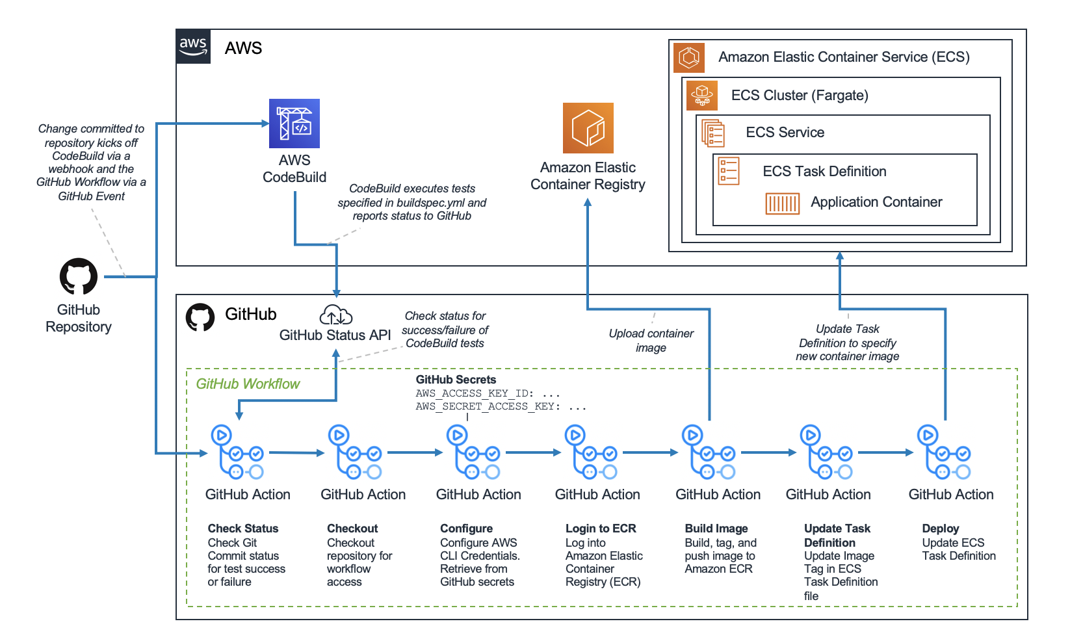

Slide 13
CI Tools
Pre-commit hooks (Run test once code changes happen)
GitHub Flow Actions
Build Scripts (sequence of tests)
Format flake8, black (code standard)
Static code analysis tools – Sonar to notify poor coding practices
Alerts (Notify when build fails)

Slide 14
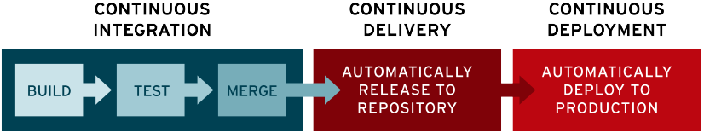
Term CI/CD
The "CI" in CI/CD always refers to continuous integration, which is an automation process for developers.
The "CD" in CI/CD refers to continuous delivery and/or continuous deployment, which are related concepts that sometimes get used interchangeably. Both are about automating further stages of the pipeline, but they’re sometimes used separately to illustrate just how much automation is happening.

